Slide 1
Lesson 4

Slide 2
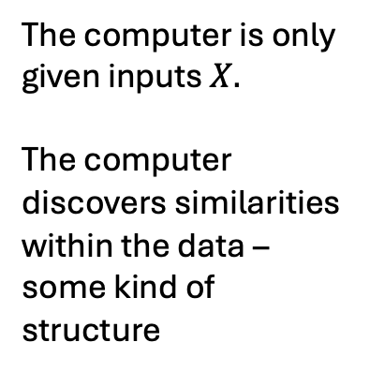
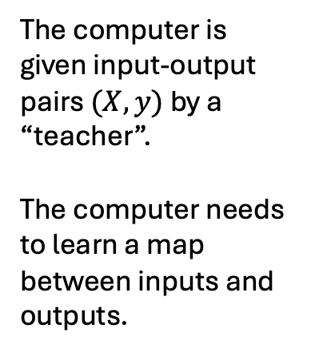
Machine Learning Catagories
Supervised Learning
Unsupervised Learning
Reinforcement Learning
The computer is given input-output pairs $(X, y)$ by a “teacher”.
The computer needs to learn a map between inputs and outputs.
The computer is only given inputs $X.$
The computer discovers similarities within the data – some kind of structure
The computer interacts with an environment with a specific goal.
Program is given feedback through rewards – good behaviour rewarded, bad behaviour punished.

Slide 3
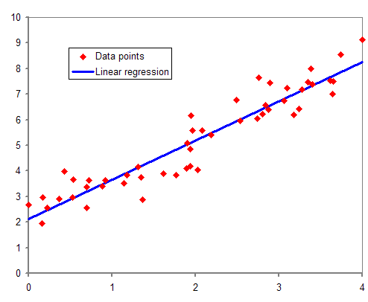
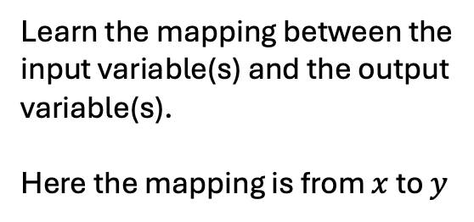
Supervised learning: Regression
Learn the mapping between the input variable(s) and the output variable(s).
Here the mapping is from $x$ to $y$
y
x

Slide 4
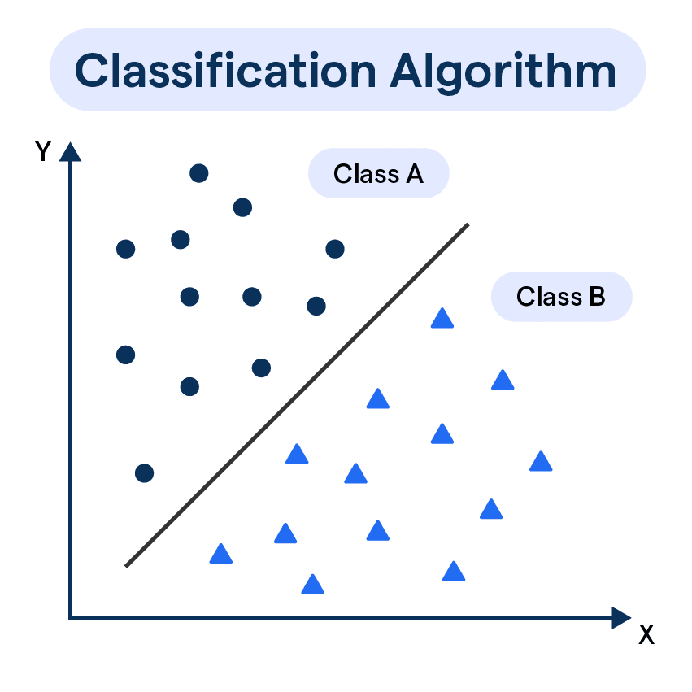
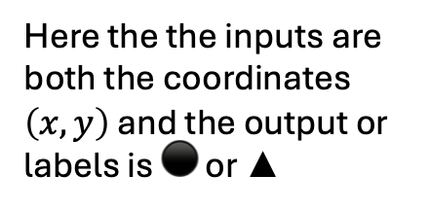
Supervised learning: Classification
One classification algorithm involves finding a line (or plane) that best divides the two classes.
Here the the inputs are both the coordinates $\left(x, y\right)$ and the output or labels is ⚫ or ▲

Slide 5
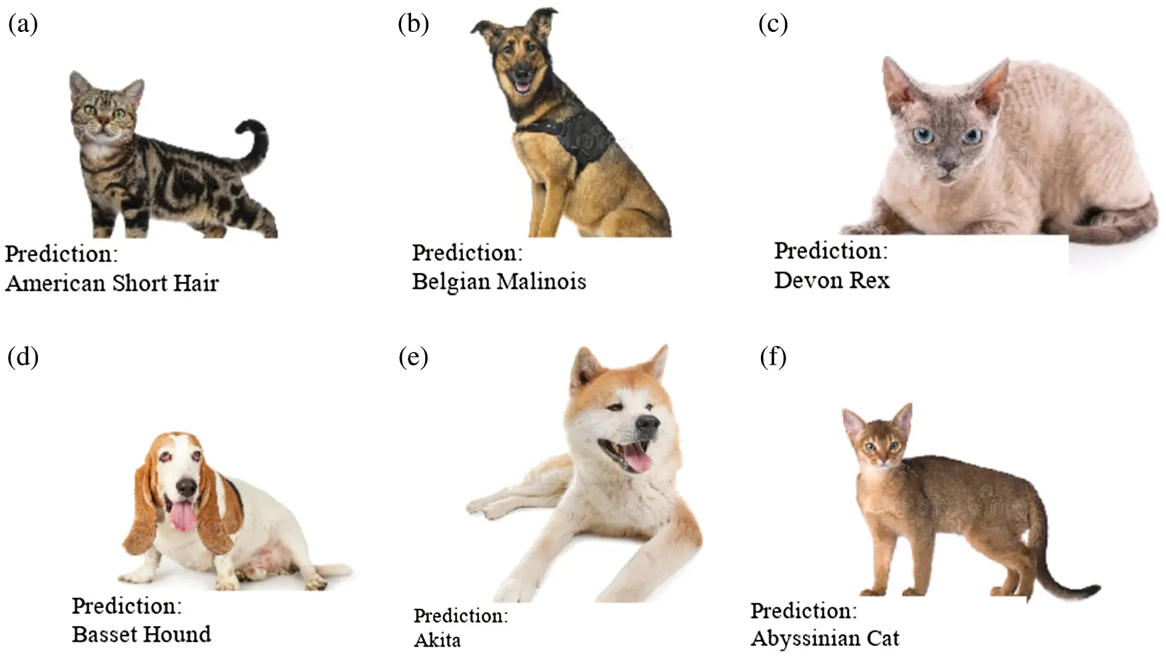
Supervised learning: Classification
Animal classification.
Input: A picture of an animal.
Output: The species of the animal
Images have thousands of dimensions.

Slide 6
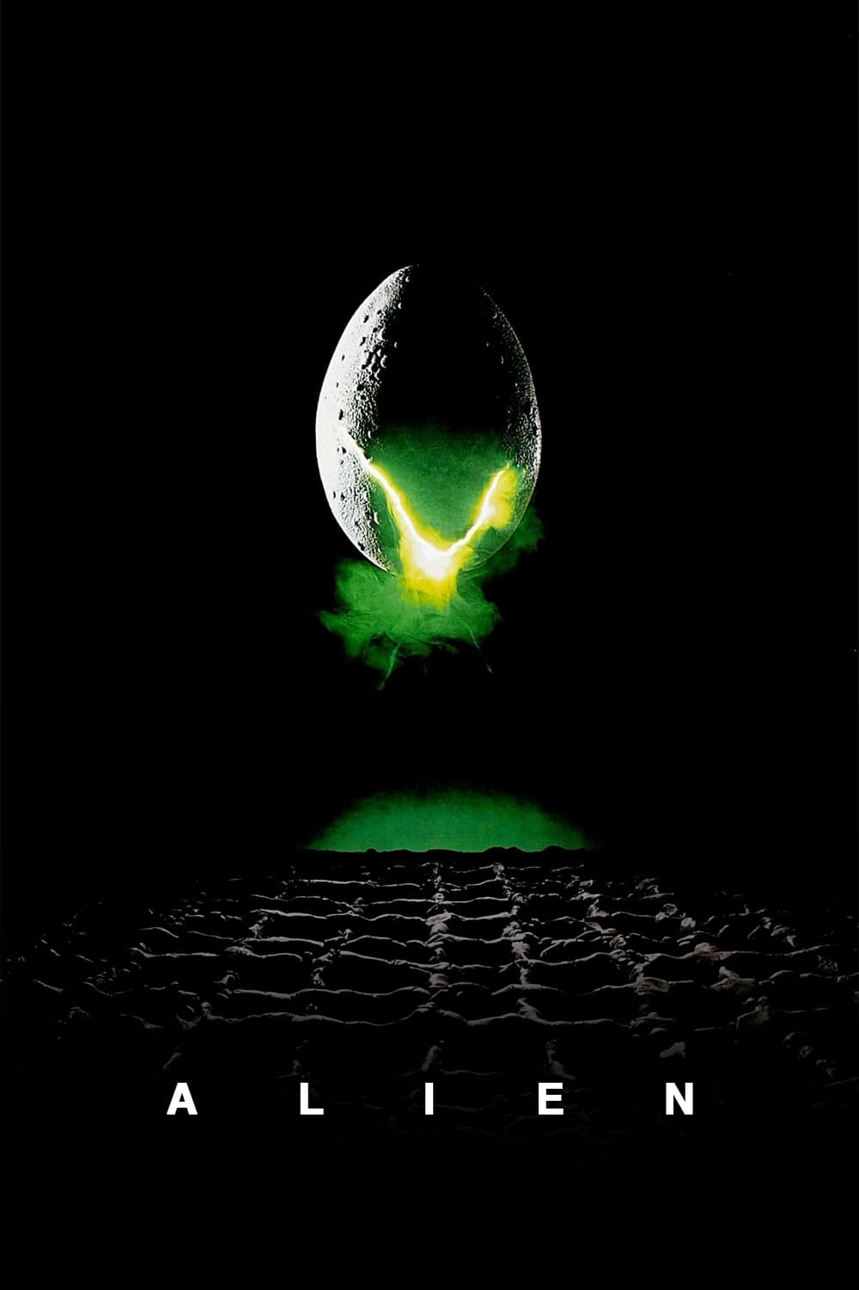
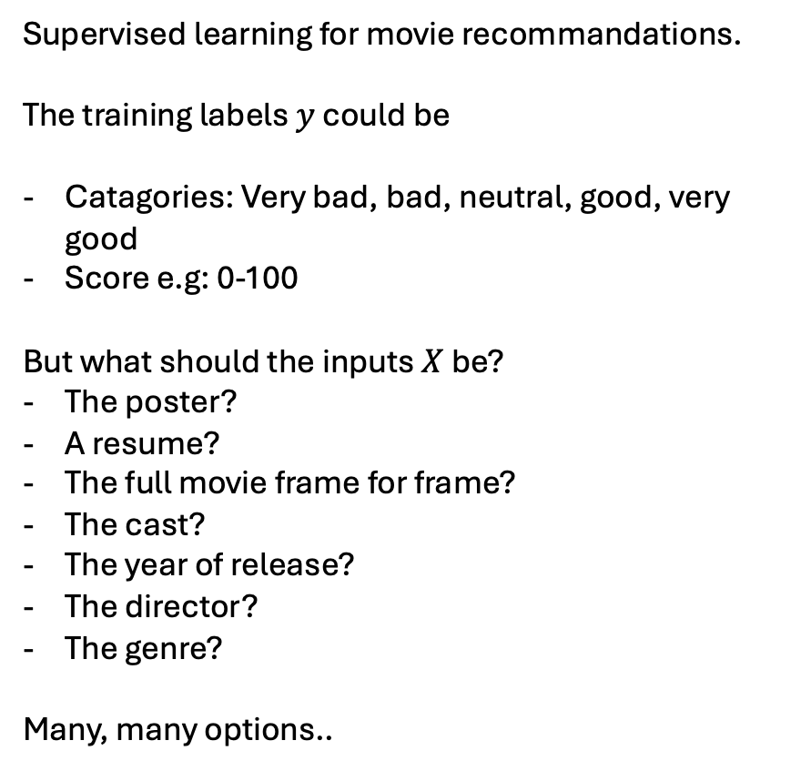
Supervised learning
Supervised learning for movie recommandations.
The training labels $y$ could be
Catagories: Very bad, bad, neutral, good, very good
Score e.g: 0-100
But what should the inputs $X$ be?
The poster?
A resume?
The full movie frame for frame?
The cast?
The year of release?
The director?
The genre?
Many, many options..

Slide 7
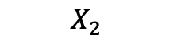
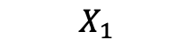
Unsupervised Learning
Data has no labels, only the inputs are known
$$X_{2}$$
$$X_{1}$$

Slide 8
Unsupervised Learning: Clustering
Data has no labels, only the inputs are known
Clustering algorithms can be used to discover “clusters” of data.
$$X_{2}$$
$$X_{1}$$

Slide 9
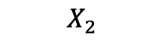
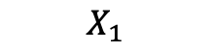
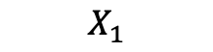
Unsupervised Learning: Dimensionality Reduction
Data has no labels, only the inputs are known
Dimensionality
reduction
$$X_{2}$$
$$X_{1}$$
$$X_{1}$$

Slide 10
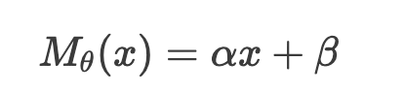
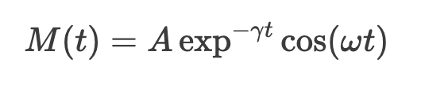
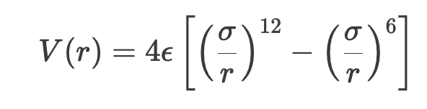
Models
”Regression” models
Machine learning models
Neural networks
Kernel models
Decision Trees
Random Forests
Models are very expressive and can adapt to data – little predefined behaviour.
Models have few learnable parameters, and have predefined behaviour.

Slide 11
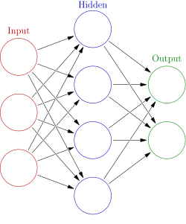
Neural Networks
You might have seen depictions like this

Slide 12
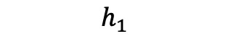
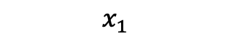
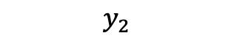
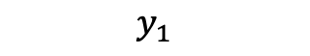
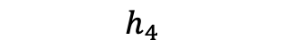
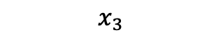
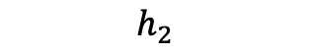
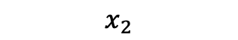
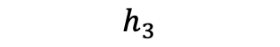
Neural Networks
$$h_{1}$$
The input is three numbers
$$x_{1}$$
Output is two numbers
$$h_{2}$$
$$y_{1}$$
$$x_{2}$$
$$h_{3}$$
$$y_{2}$$
$$x_{3}$$
$$h_{4}$$
Input is converted to four numbers

Slide 13
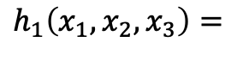
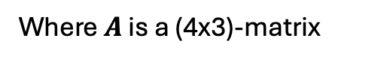
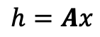
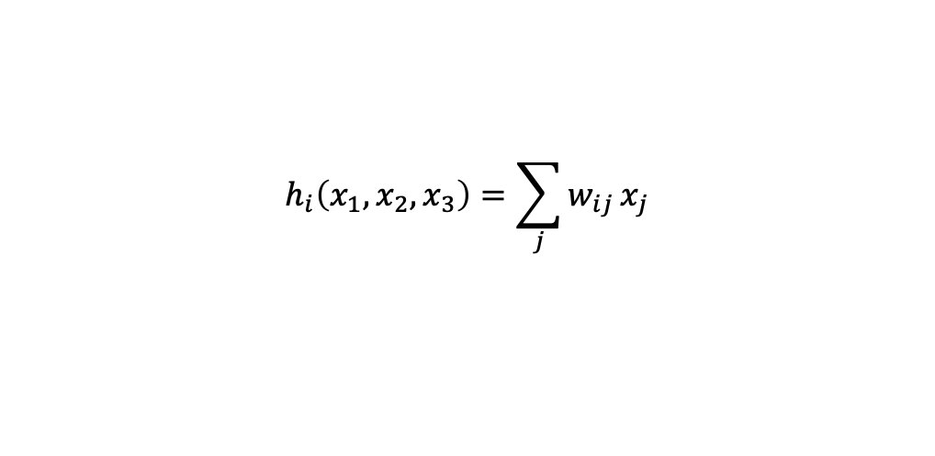
Neural Networks
How is this calculated?
$$h_{1}$$
$$h_{1}\left(x_{1},x_{2},x_{3}\right)=$$
$$x_{1}$$
$$w_{11}x_{1}+w_{12}x_{2}+w_{13}x_{3}$$
$$h_{2}$$
$$y_{1}$$
Linear combination of inputs.
$$x_{2}$$
$$h_{i}\left(x_{1},x_{2},x_{3}\right)=\sum_{j}{w_{ij}}x_{j}$$
$$h_{3}$$
$$y_{2}$$
Or in matrix notation
$$x_{3}$$
$$h=Ax$$
Where $A$ is a (4x3)-matrix
$$h_{4}$$

Slide 14
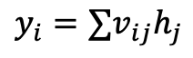
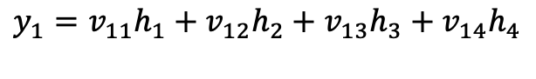
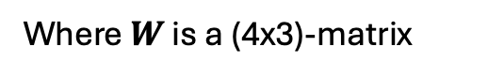
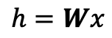
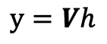
Neural Networks
The operation between the hidden layer and the output is also a linear combination
$$h_{1}$$
$$y_{1}=v_{11}h_{1}+v_{12}h_{2}+v_{13}h_{3}+v_{14}h_{4}$$
$$h_{1}\left(x_{1},x_{2},x_{3}\right)=$$
$$x_{1}$$
Or again
$$w_{11}x_{1}+w_{12}x_{2}+w_{13}x_{3}$$
$y_{i}=∑v_{ij}h_{j}$
$$h_{2}$$
$$y_{1}$$
Linear combination of inputs.
$$x_{2}$$
$$h_{i}\left(x_{1},x_{2},x_{3}\right)=\sum_{j}{w_{ij}}x_{j}$$
And in matrix notation
$$h_{3}$$
$$y_{2}$$
$$y=Vh$$
Or in matrix notation
$$x_{3}$$
Where V is a (2x4)-matrix
$$h=Wx$$
Where $W$ is a (4x3)-matrix
$$h_{4}$$

Slide 15
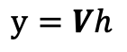
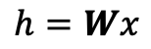
Neural Networks
We have
$$h_{1}$$
$$h=Wx$$
$$y=Vh$$
$$x_{1}$$
So we can put it together
$$h_{2}$$
$$y_{1}$$
$$y=V\left(Wx\right)=\left(VW\right)x=Qx$$
$$x_{2}$$
This would make the network just a linear transformation…
$$h_{3}$$
$$y_{2}$$
$$x_{3}$$
$$h_{4}$$

Slide 16
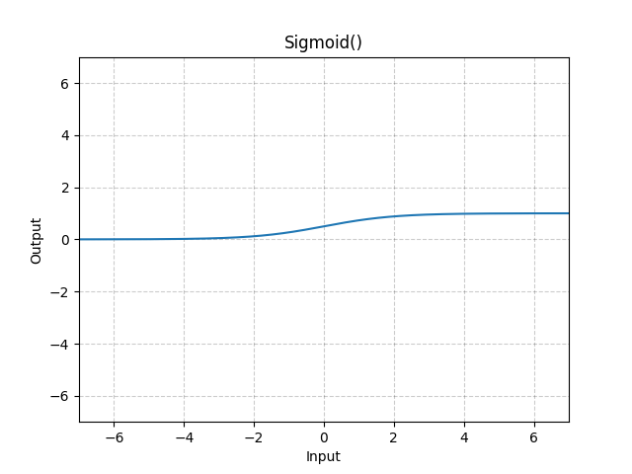
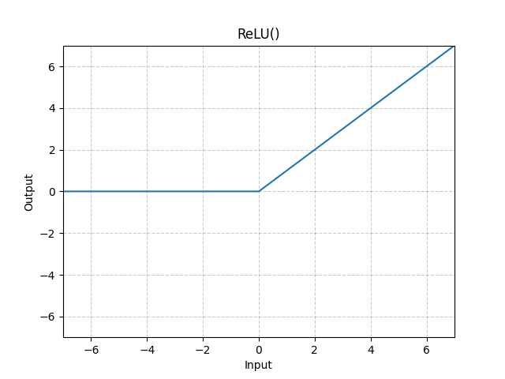
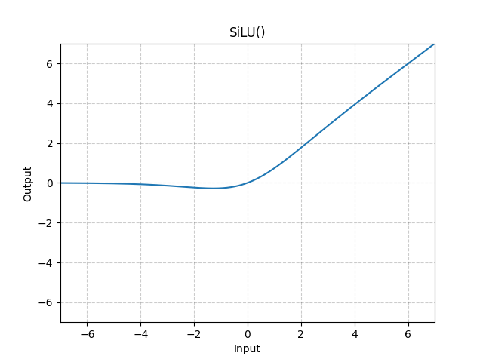
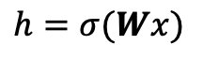
Neural Networks
The solution is activation functions
$$h_{1}$$
$$h=σ(Wx)$$
$$y=Vh$$
$$x_{1}$$
So we can put it together
$$h_{2}$$
$$y_{1}$$
$$y=Vσ\left(Wx\right)$$
$$x_{2}$$
This would make the network just a linear transformation…
$$h_{3}$$
$$y_{2}$$
$$x_{3}$$
$$h_{4}$$

Slide 17
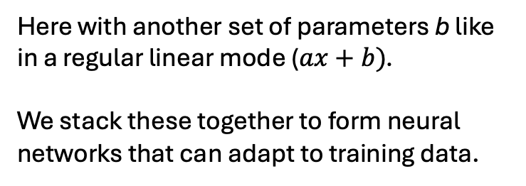
Neural Networks
Feed forward neural networks with linear layers
$$h=σ\left(Wx+b\right)$$
Here with another set of parameters b like in a regular linear mode ($ax+b)$.
We stack these together to form neural networks that can adapt to training data.

Slide 18
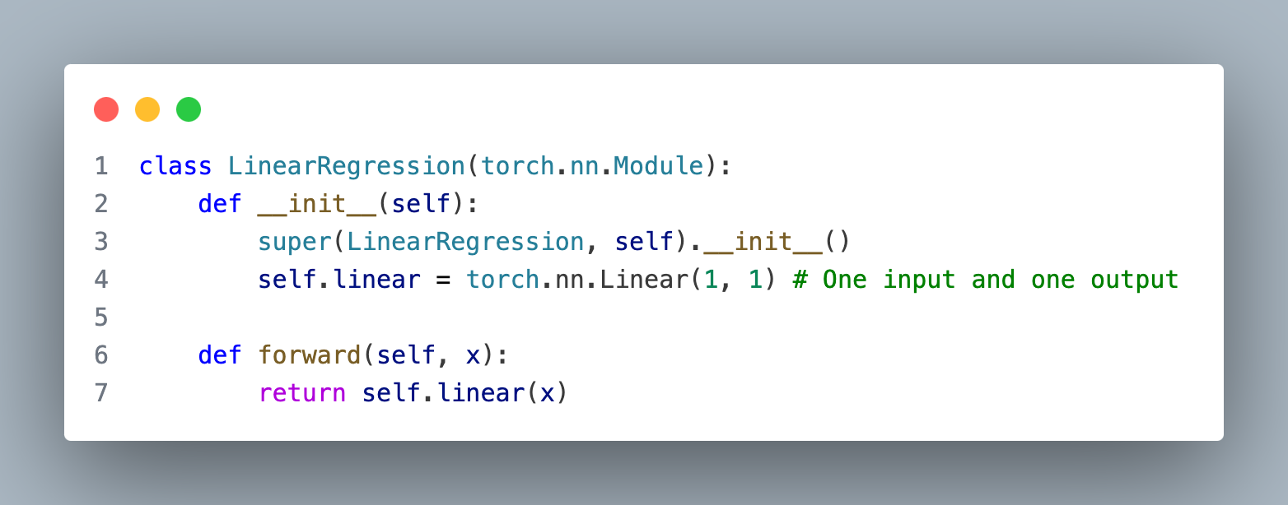
Neural Networks in Pytorch
We can recreate a normal linear model: $ax+b$

Slide 19
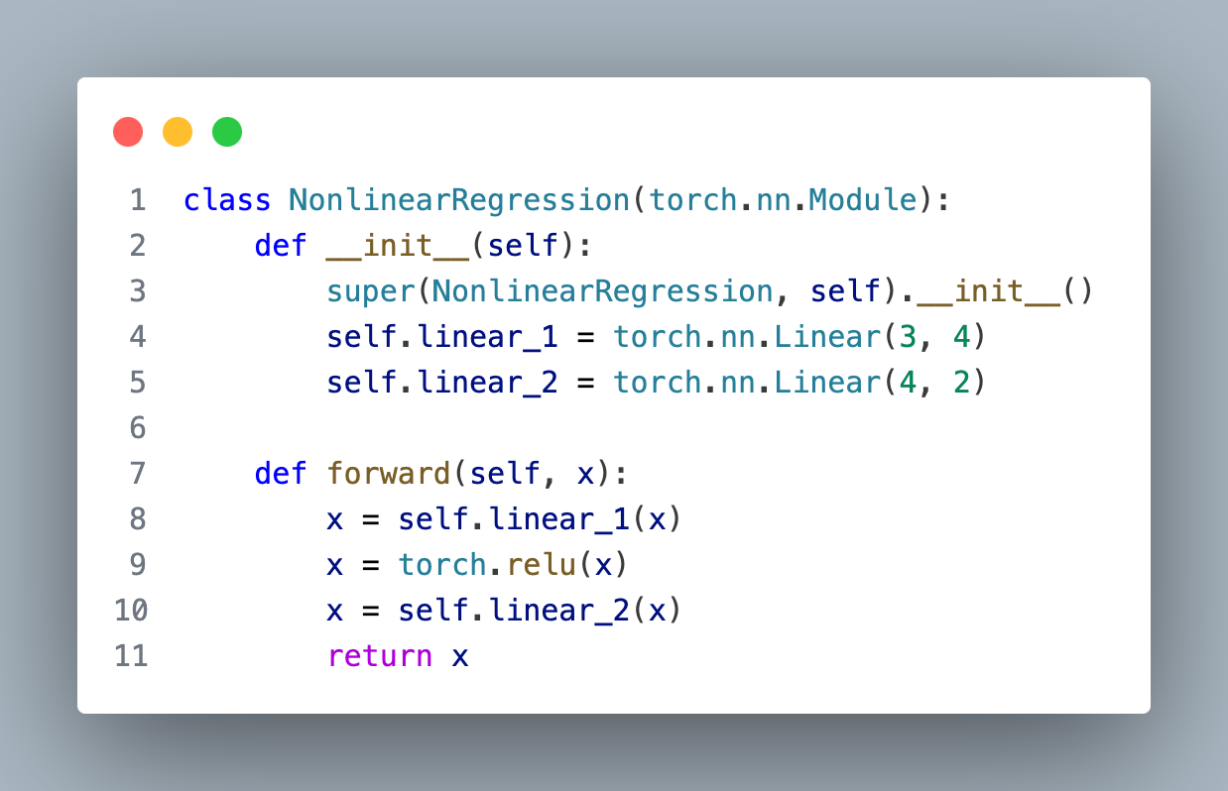
Neural networks in Pytorch

Slide 20
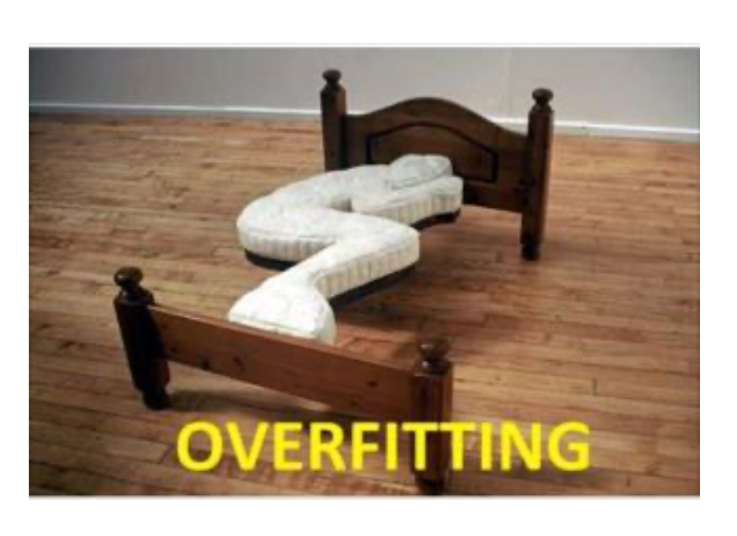
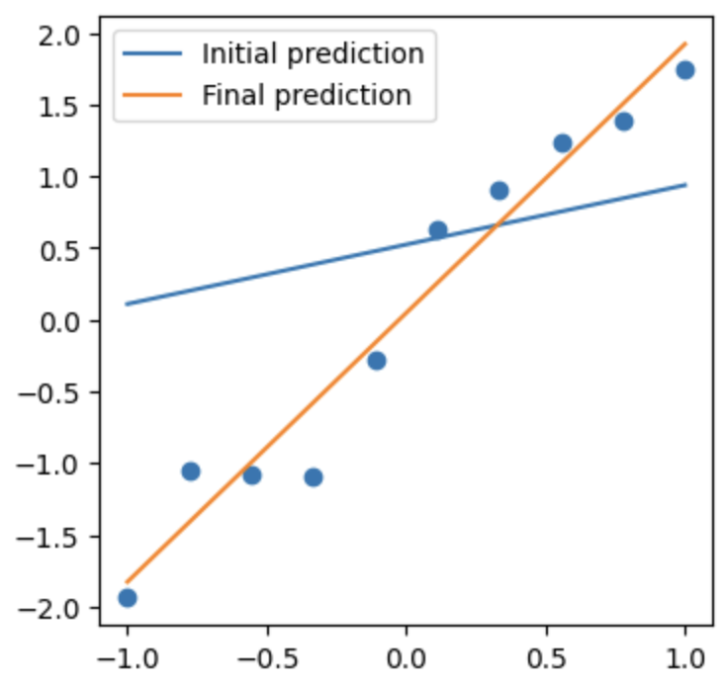
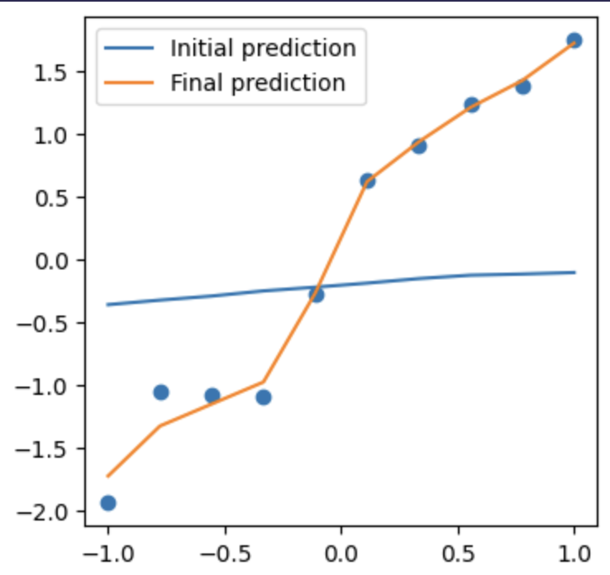
Overfitting: Gotta be careful

Slide 21
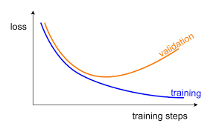
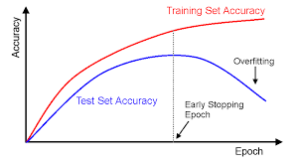
Overfitting: Validation / Test

Slide 22

A little history

Slide 23

Convolutional Neural Networks

Slide 24

AlexNet Architecture

Slide 25

Deep Learning

